Slide 1
BIODIVERSITY PROJECT
Analysis of data from the National Parks Service about endangered species in different parks.
Created by Olga Skripnichenko

Slide 2
GOALS AND STRUCTURE OF THE PROJECT
The main objectives are:
Carry out data analysis on the conservation statuses of species;
Investigate if there are any patterns or themes to the types of species that become endangered;
Identify and provide information to the National Park Service that can be useful for the conservation of biodiversity.
A list of visualizations:
brief description of data;
species composition according to their categories;
species composition according to their statuses;
how species are distributed by status in each category;
distribution of the number of observations;
observation boxplots for each park;
How to identify species that are at risk of changing their status to a more dangerous one.

Slide 3
DESCRIPTION OF DATA
Data sources
species_info.csv
category - class of animal
scientific_name - the scientific name of each species
common_name - the common names of each species
conservation_status - each species current conservation status
observations.csv
scientific_name - the scientific name of each species
park_name - the name of the park in which this species was observed
observations - the number of observations in the past 7 days
Short dataframe review:
Number of species: 5541
Parks: ['Bryce National Park' 'Great Smoky Mountains National Park' 'Yellowstone National Park' 'Yosemite National Park’]
Number of observations: 3154261.0
Categories: ['Vascular Plant' 'Nonvascular Plant' 'Bird' 'Amphibian' 'Reptile' 'Mammal' 'Fish’]
Statuses: ['1 - Not Evaluated' '2 - Species of Concern' '3 - Threatened' '5 - In Recovery' '4 - Endangered']

Slide 4
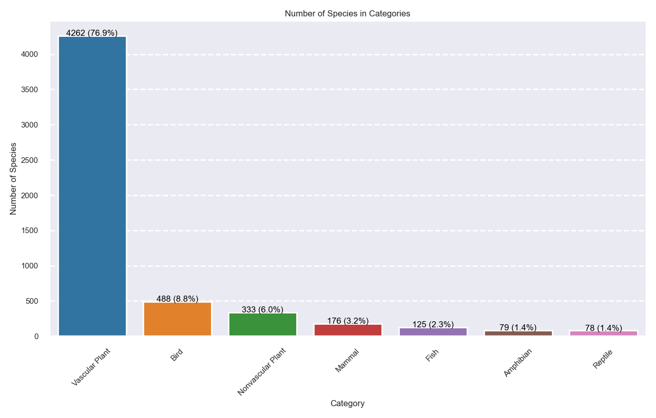
Species composition according to their categories

Slide 5
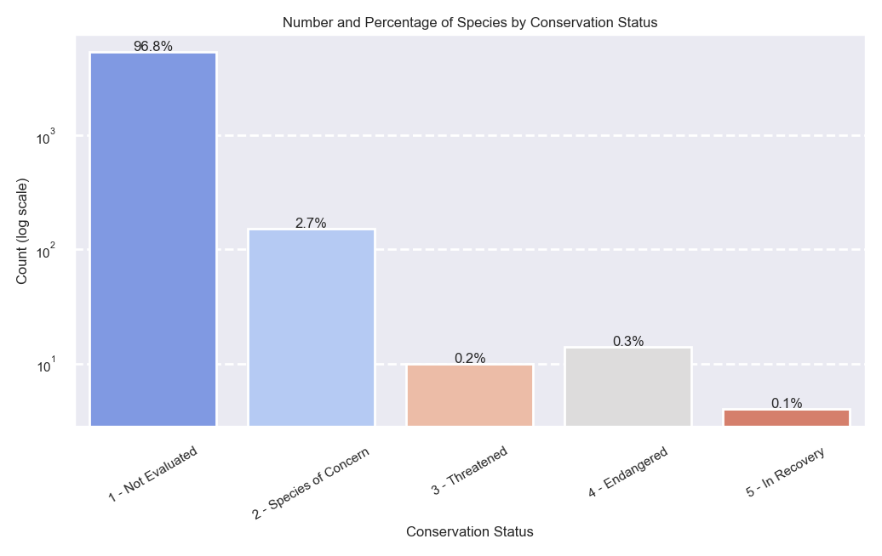
Species composition according to their statuses

Slide 6
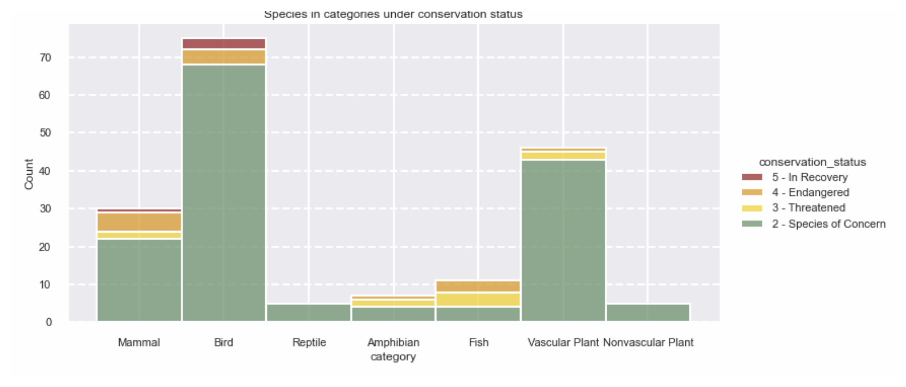
How species are distributed by status in each category

Slide 7
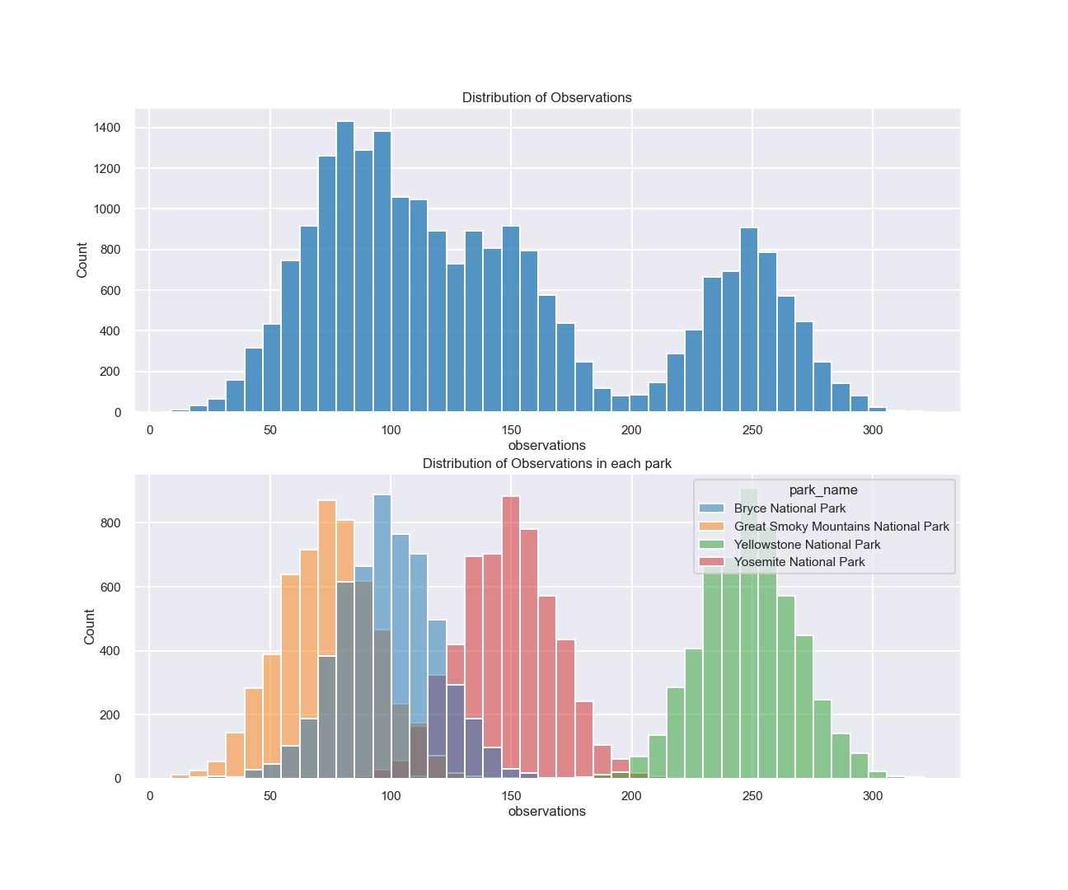
Distribution of the number of observations
The position of each distribution of observations relative to others is determined by the number of observations.
We see that Yellowstone National Park has more observations than others. This difference in the number of observations due to the size of the parks (Yellowstone is the largest).
Further we will look at the distribution of observations for each park separately.

Slide 8
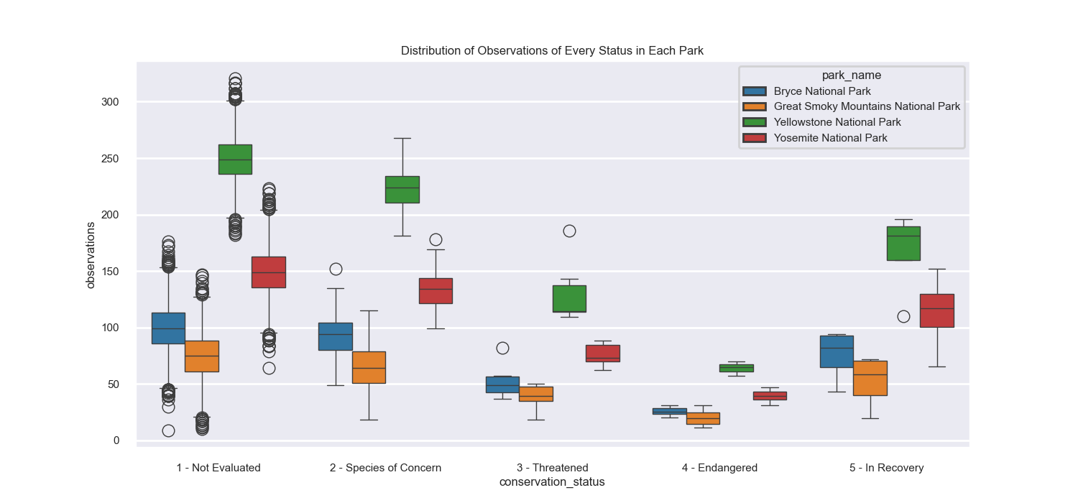
Observation boxplots for each park

Slide 9
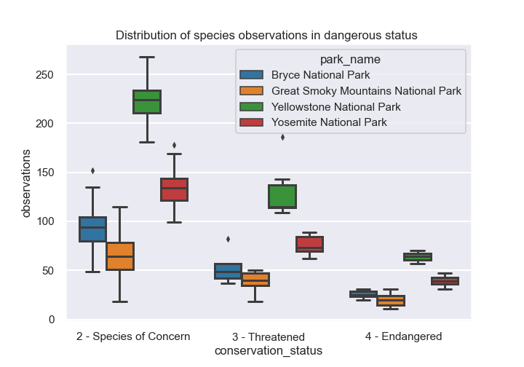
How to identify species that are at risk of changing their status to a more dangerous one
Identify species whose observation counts are significantly lower than the typical values for their group or fall within the interquartile range (IQR) of a more critical conservation status.
We will focus on species classified as Species of Concern, Threatened, or Endangered.

Slide 10
Conclusions and further research
76% of all observed species are vascular plants. Other groups include nonvascular plants, mammals, birds, fish, amphibians, and reptiles.
Approximately 97% of all species have not been assigned a conservation status, with only 179 species currently classified as protected.
Mammals and birds appear to be at greater risk
Observations within each park follow a normal distribution..
We identified a relationship between conservation status and the number of observations by constructing boxplots for each park. However, statistical testing was not appropriate for this dataset due to unequal variance.
Following our analysis, we compiled a list of species that require particular attention from each park to prevent their conservation status from worsening. This list is available in the dictionary named dict_warning.
Since the distribution of observations is not normal, we analysed the data for each park separately. Taking park sizes into account, future analysis could incorporate the metric of observations per square metre to allow for comparisons across parks.
Conservation status assessments consider multiple factors beyond population size alone. Therefore, further research should include data on population trends over time.

